Slide 1

A Risk Adjustment Model for Home Health Agencies

Slide 2

About Us
Elisa White
Erica Rosa
Jensen Binoji
Ted Stagner
Tim Halligan
Our mission is to find solutions to improve the deliverance of cost efficient healthcare as Medicare moves towards a value based reimbursement structure.

Slide 3
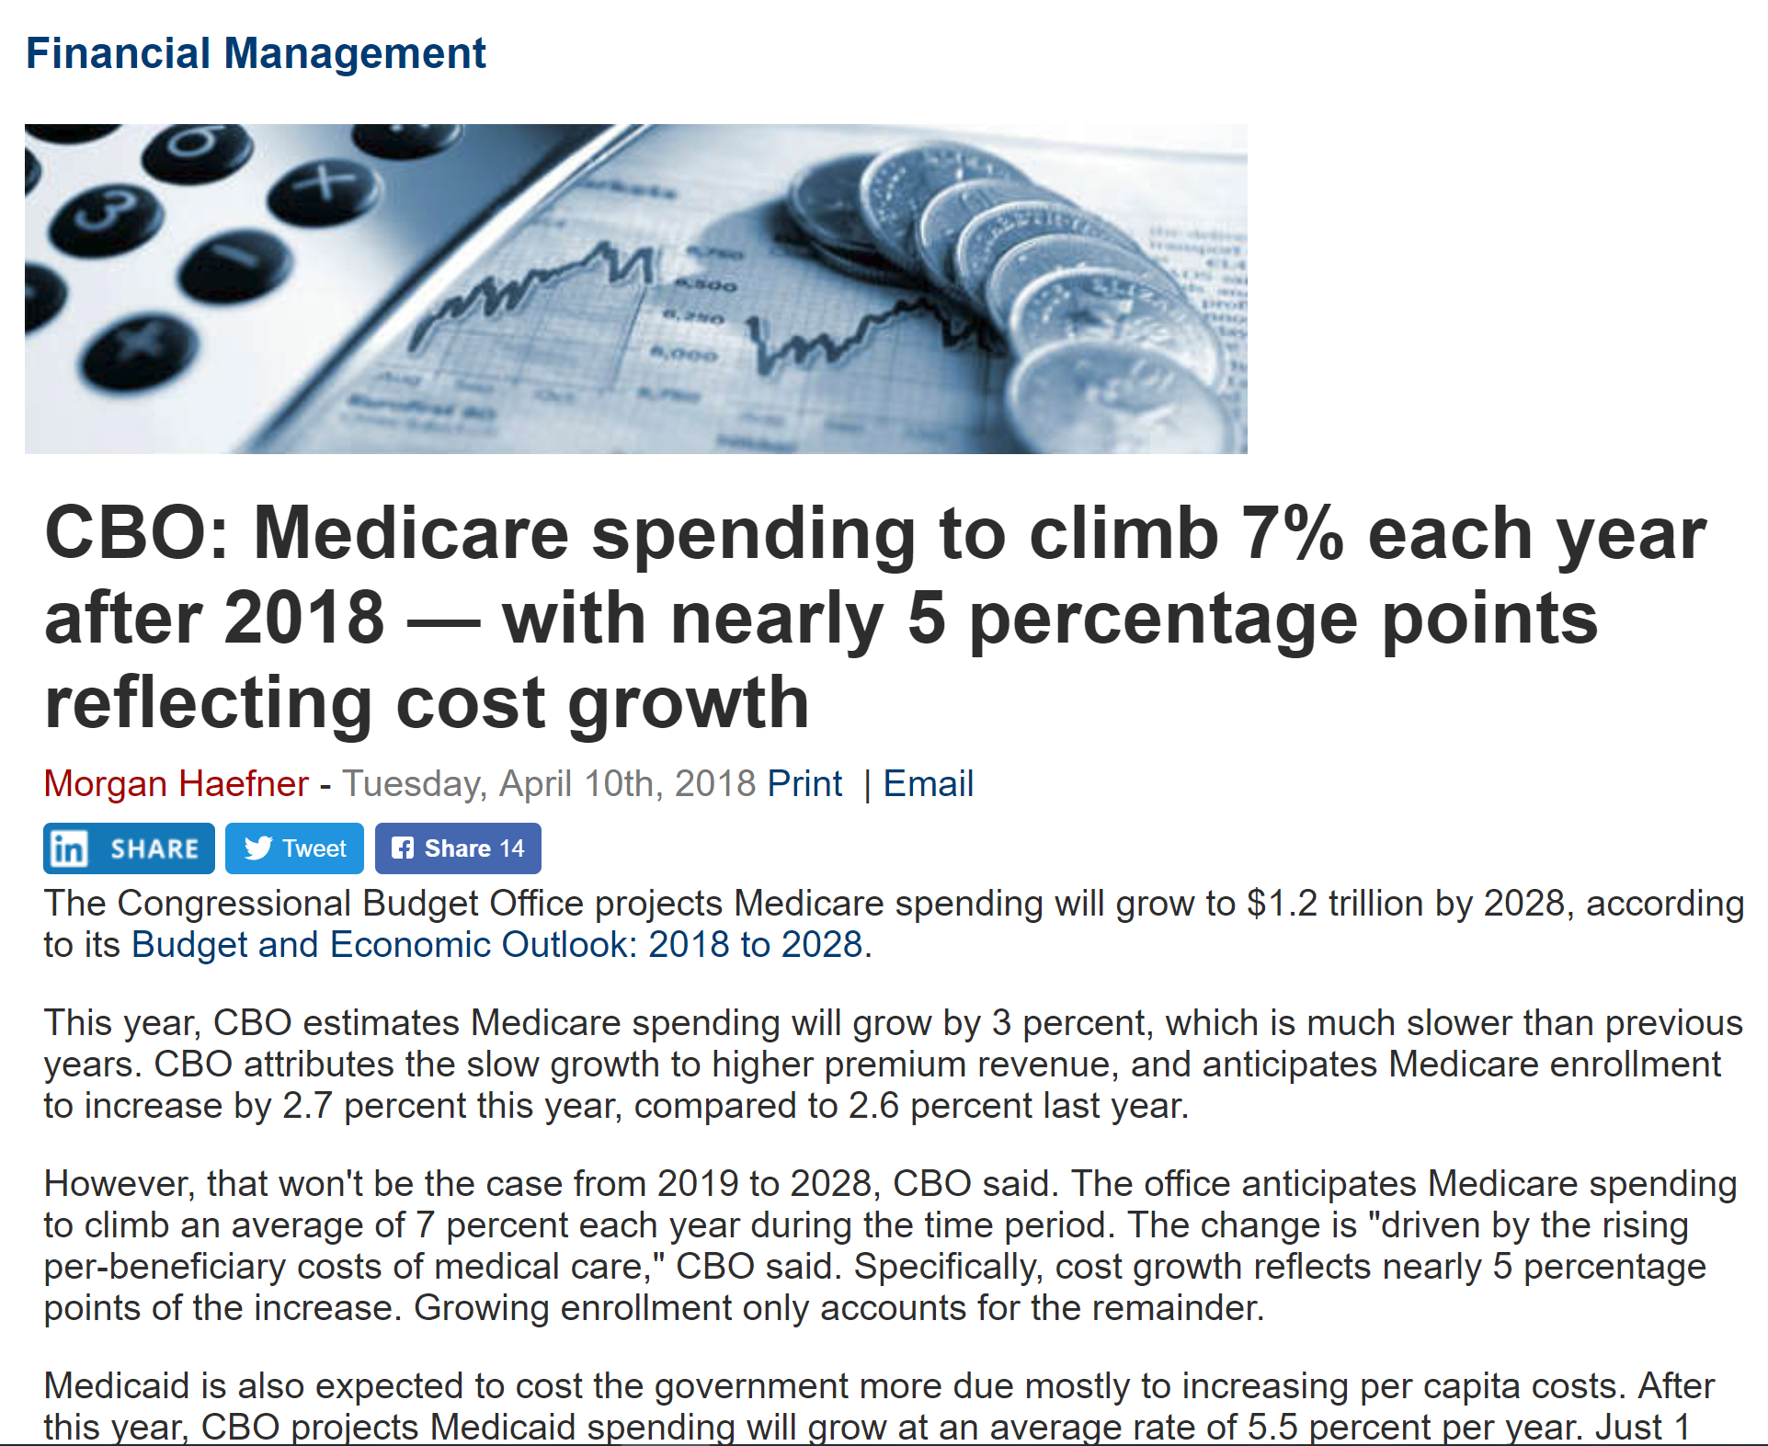
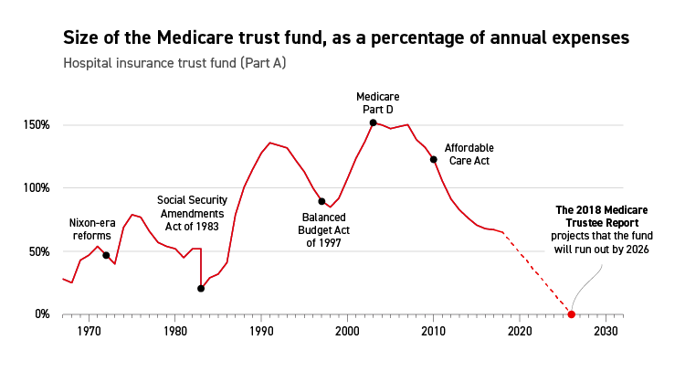
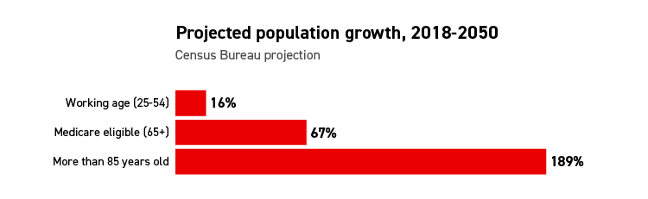
The Problem
Increasing Medicare Population
Increasing Medicare Spend
Decreasing Funding
The Medicare Population is projected to increase at a greater rate than any other demographic.
Medicare Beneficiary spending is expected to continue rising annually.
The Medicare fund is projected to be depleted by 2026.
https://www.politico.com/agenda/story/2018/09/12/medicare-baby-boomers-trust-fund-000694

Slide 4




Solution
Prioritize
Model
Monetize
Home Health Dataset Analysis for understanding of current population.
Create Risk Adjustment model using Home Health Dataset
Use model to recommend expenditure adjustments
Create a Risk Adjustment model for high risk beneficiary predictions to adjust reimbursement for improved cost effective care.

Slide 5

Dataset Preliminary Analysis

Slide 6
Hierarchical Condition Category (HCC) Scores
In some payment models, payers reimburse providers a flat rate per patient (capitation), and in others, payers assess penalties or provide bonuses based on cost or quality of care outcomes (pay-for-performance). In such payment models, risk adjustment is important. Risk adjustment mechanisms predict whether a given patient, or group of patients, is likely to be more or less costly to treat than the average population and provides a way to adjust payment accordingly. Risk adjustment compensates health plans and providers for treating sicker patients, and reduces their incentives to select healthy or less costly patients.
Risk adjustment mechanisms predict whether a given patient, or group of patients, is likely to be more or less costly to treat than the average population and provides a way to adjust payment accordingly. The Centers for Medicare & Medicaid Services (CMS) risk adjustment model is a hierarchical condition category (HCC) score. Use of the HCC model is expanding, and there is concern over whether it functions as intended. If CMS-HCC risk scores do not accurately reflect patient health status because of factors such as coding practices or capacity, then payments may not be associated with the true cost of treatment.

Slide 7
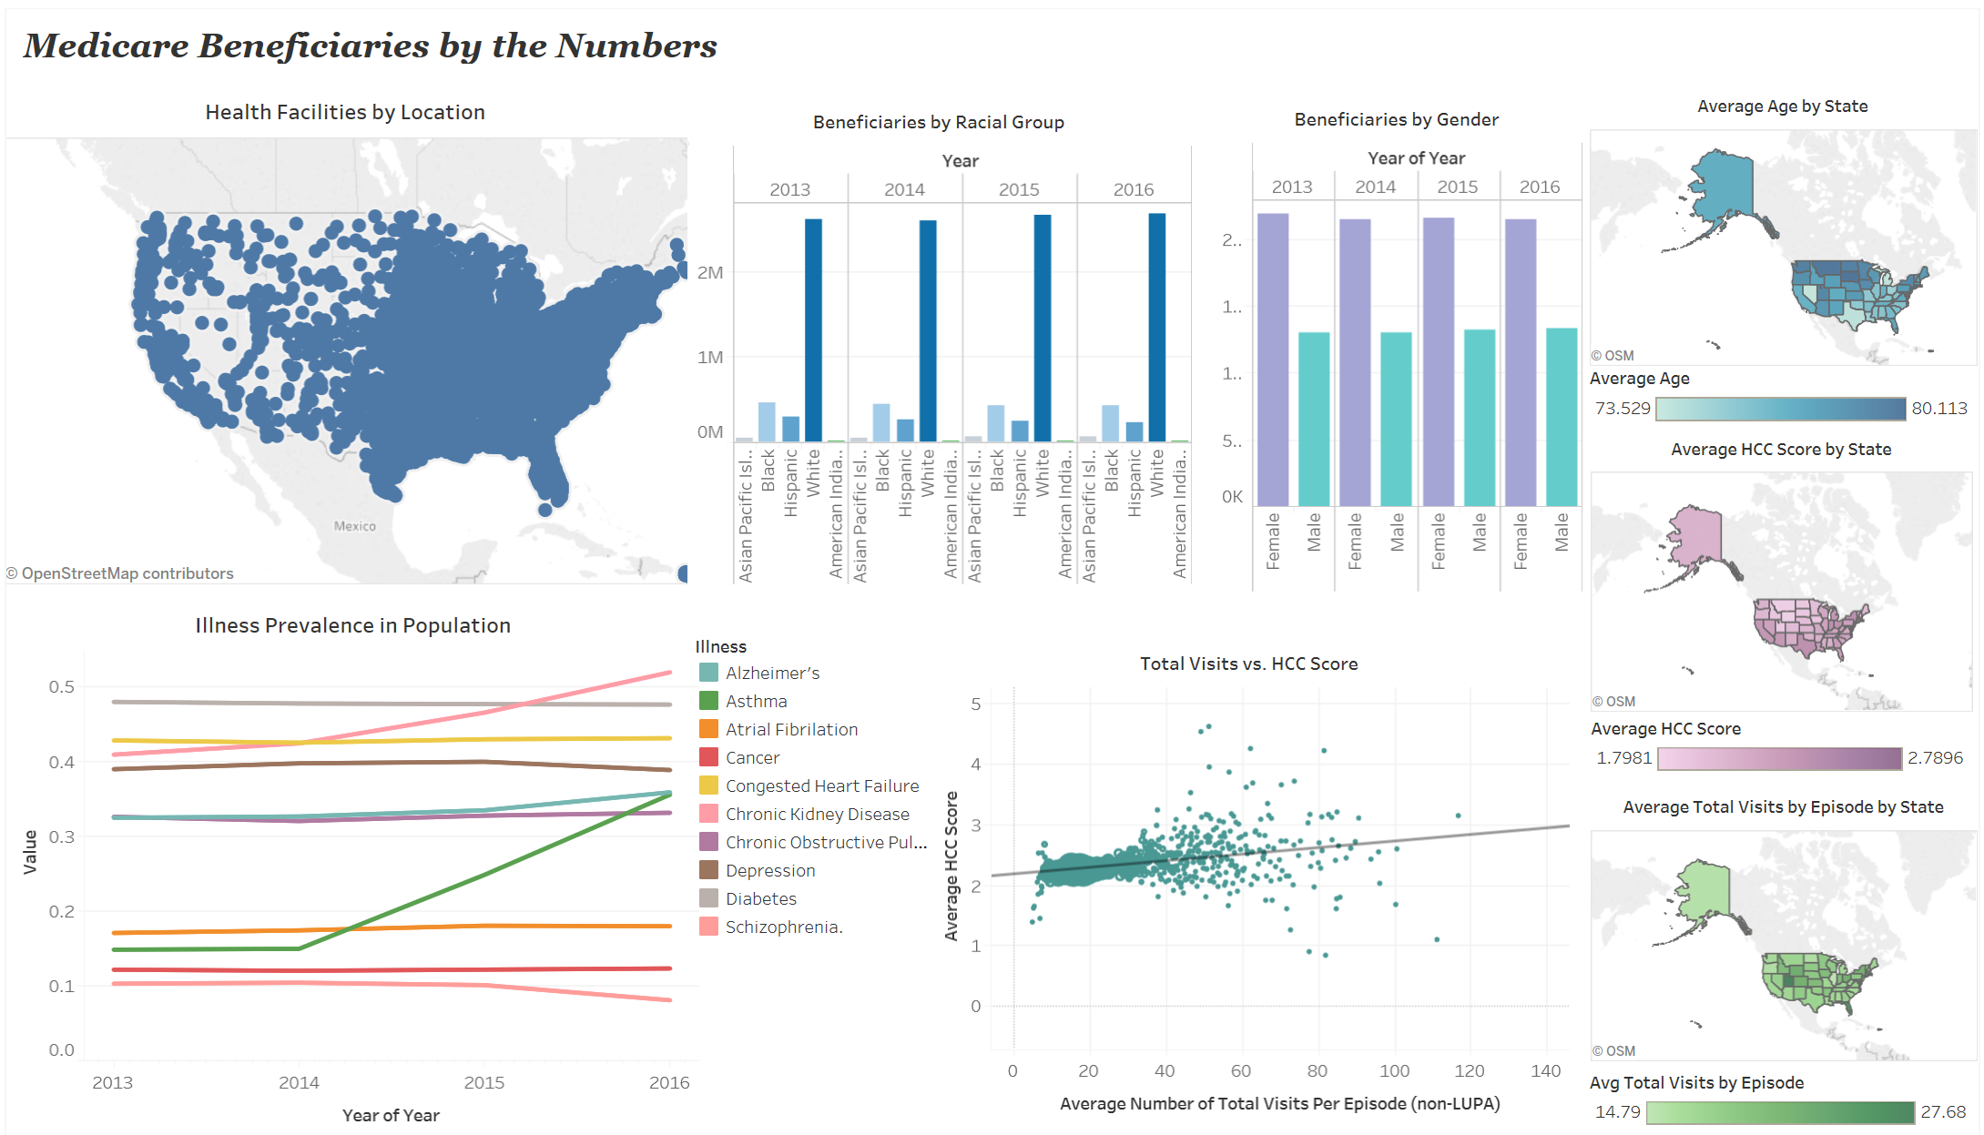

Slide 8
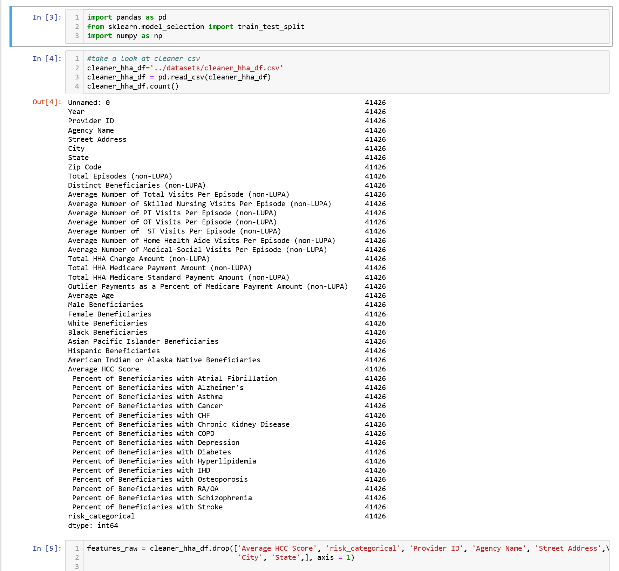

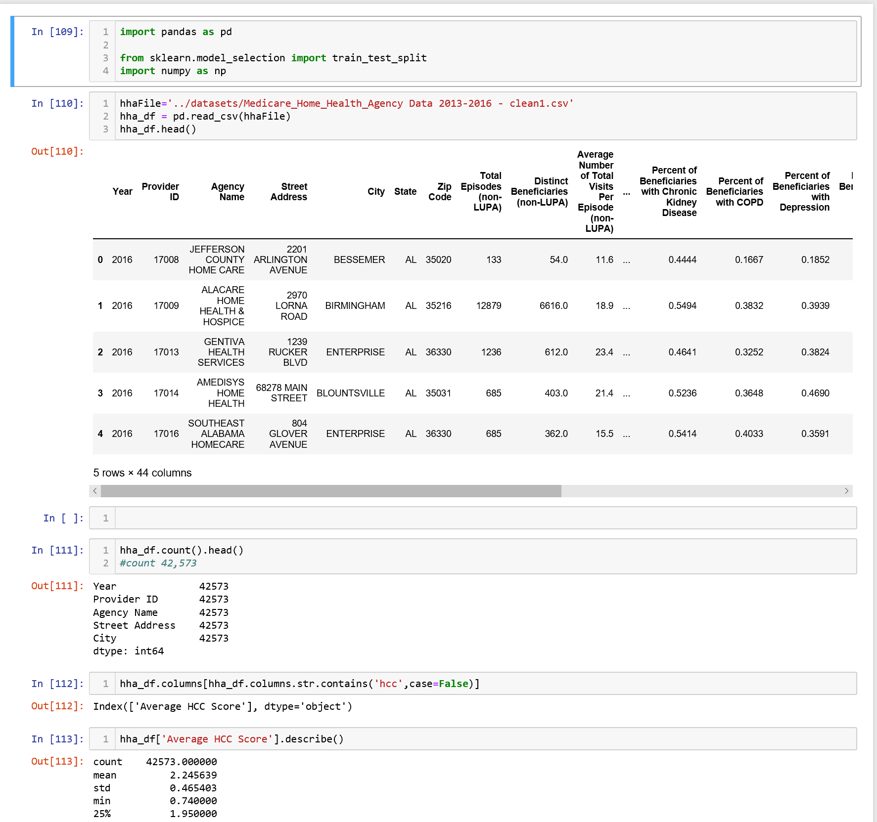
The Model
Deep Learning
Regression

Slide 9

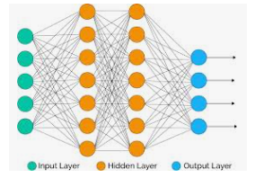
Deep Learning-Categorical
Hierarchical Condition Categories (HCC)
Originally, 2 HCC categories were created with one of them for values below 1.08
and one category for values above 1.08.
Think of HCC as a cost/illness indicator.
A higher number is a higher cost and illness.
Below 1.08 was called low risk
Above 1.08 was called high risk
Our data was somewhat ambiguously described and labeled. The data was labeled as non-LIPA
or Non- Low Utilization Payment Adjustment Data implying the data was concerned with higher healthcare utilization or higher hcc.
This seemed to be confirmed by the data:
42,000 rows had HCCs of 1.08 and above
Only 50 rows had HCCs of below 1.08
39 Features input dimension
2x10 hidden layers
2 unit output layer via softmax
Loss calculated via categorical_crossentropy

Slide 10
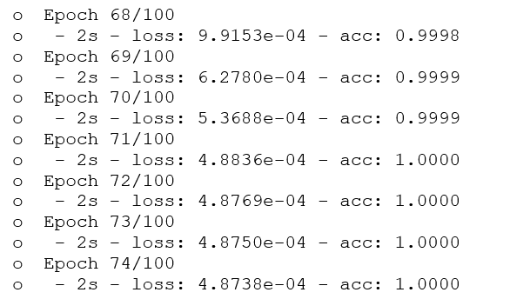
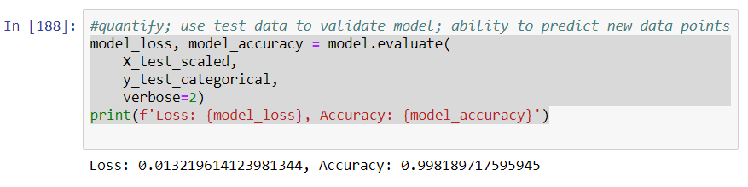
Deep Learning-Categorical
This might explain:
An accuracy near 1
And small losses
For both the training and test data sets.

Slide 11
Deep Learning-Regression
In addition to evaluating the data categorically with deep learning,
the data was evaluated with Regression and Mean Squared Error(MSE) via deep learning
1 input dimension
2x6 hidden layers
1 unit output layer via ‘linear’
Loss calculated via Mean Squared Error(MSE)

Slide 12
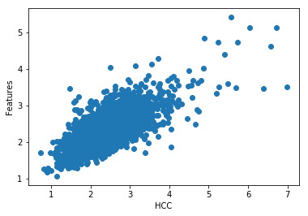
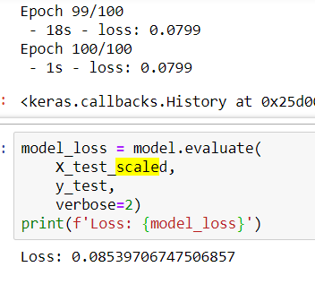
Deep Learning-Regression
Again the test train had a lower loss of around 0.08
Since this was regression we did not have an accuracy number
The prediction was plotted:
import matplotlib.pyplot as plt
%matplotlib inline
plt.scatter(y_test,model.predict(X_test_scaled))
plt.xlabel('HCC')
plt.ylabel('Features')

Slide 13
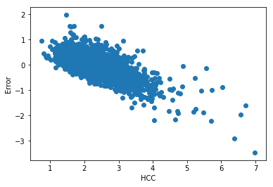
Deep Learning-Regression
Additionally, the error was checked in regards to HCC and found that the error increased with higher hcc scores:
err = model.predict(X_test_scaled)[:,0] - y_test
plt.scatter(y_test, err)
plt.ylabel('Error')
plt.xlabel('HCC')

Slide 14
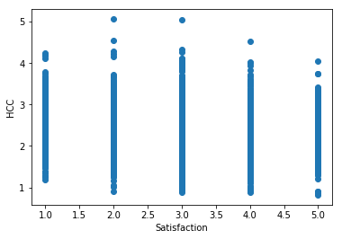
HCC vs Satisfaction
Hypothesis: with higher hcc you may see lower satisfaction
Raw data
The raw data does seem to suggest this as you see less 4 and 5 satisfaction ratings with a 4 and 5 hcc.

Slide 15
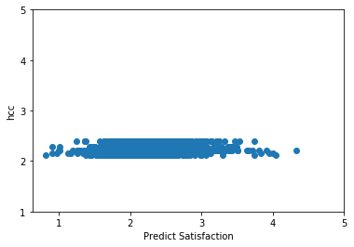
HCC vs Satisfaction
Deep Learning Regression utilized with MSE
Loss for train and test around 0.12
2x6 hidden layer
1input
1 output

Slide 16
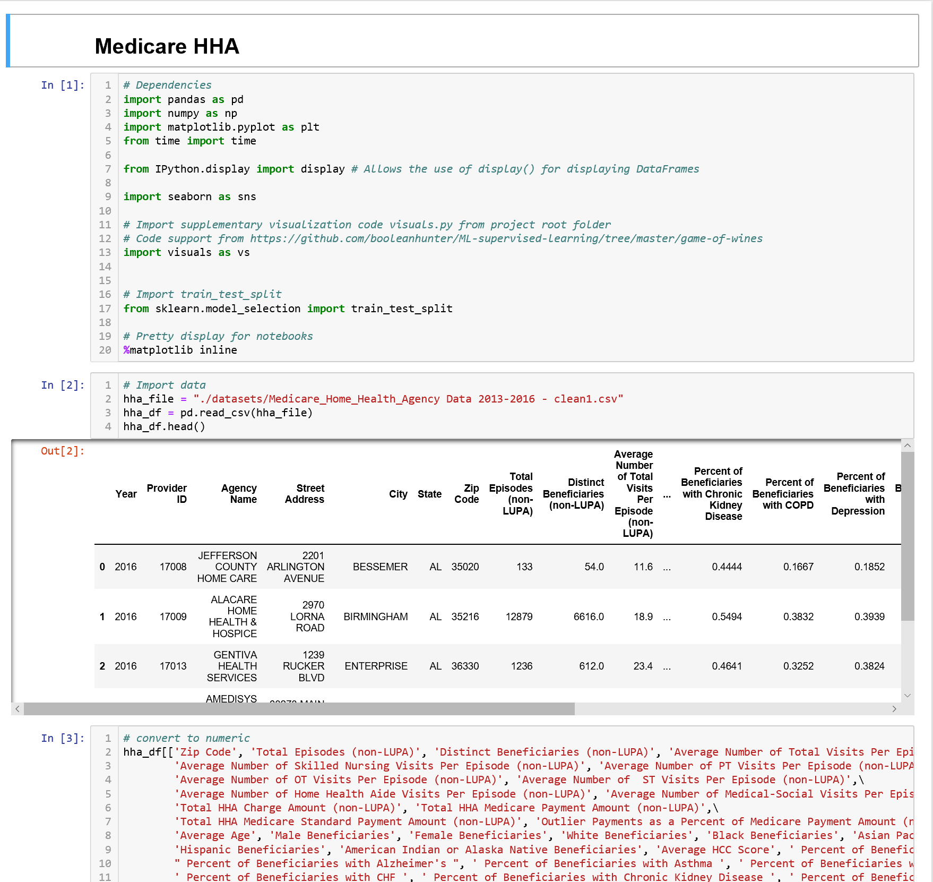
Gaussian
&
Random Forest Classifier

Slide 17
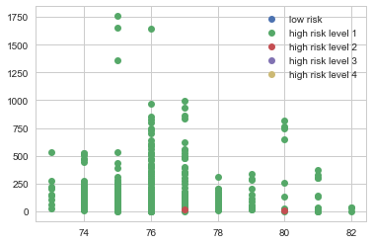
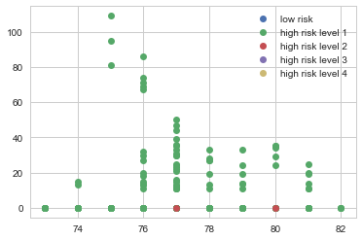
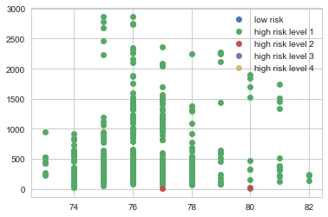
Black Beneficiaries by Risk and Age
Asian Beneficiaries by Risk and Age
White Beneficiaries by Risk and Age

Slide 18
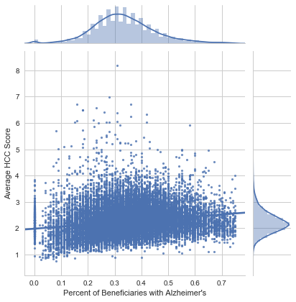
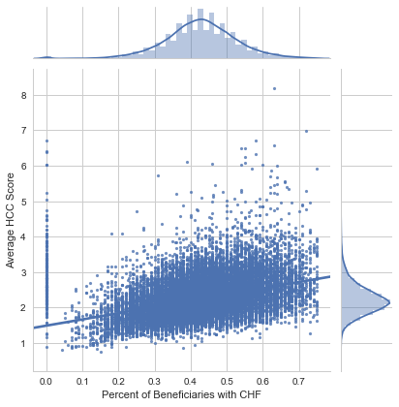
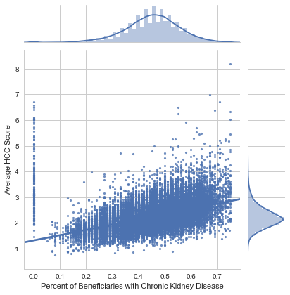
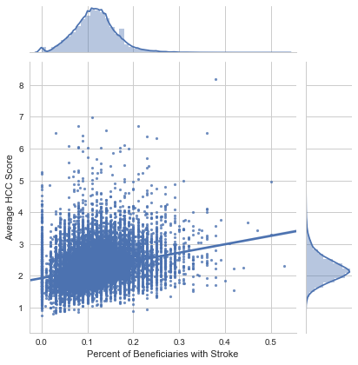
Alzheimer’s vs HCC Score
Congested Heart Failure vs HCC Score
Chronic Kidney Disease vs HCC Score
Stroke vs HCC Score

Slide 19
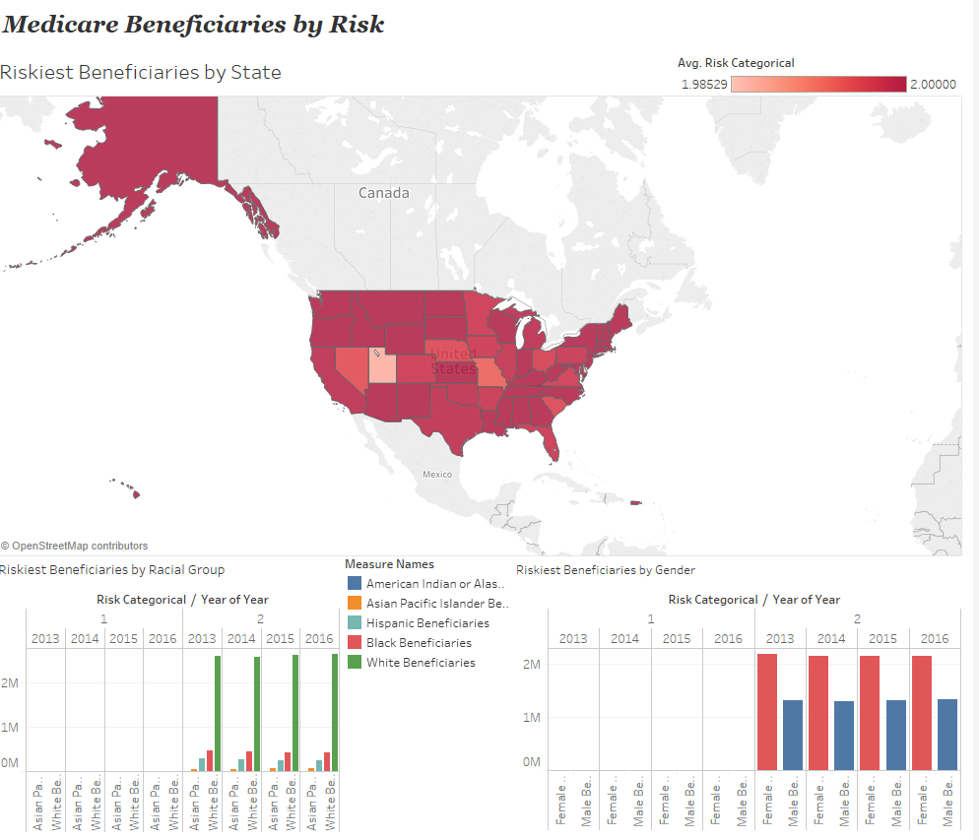

Slide 21

Summary
Medicare beneficiaries at home health facilities have consistent risk levels
Facilities with higher HCC scores have higher populations of chronic illnesses and should require additional funding for managing these populations
Consider alternative methods of treatment for low risk beneficiaries at home health facilities

Slide 22
Thank You

